Slide 1
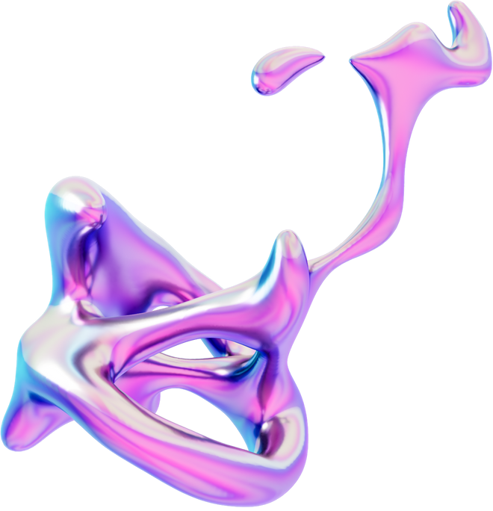

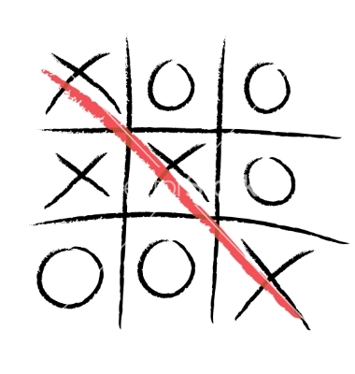

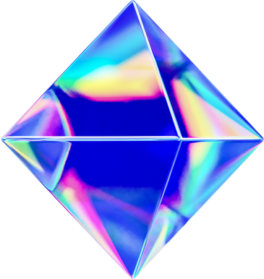


Developing a
TIC TAC TOE AI AGENT
Using Minimax and alpha-beta pruning
University of New Haven

Slide 2
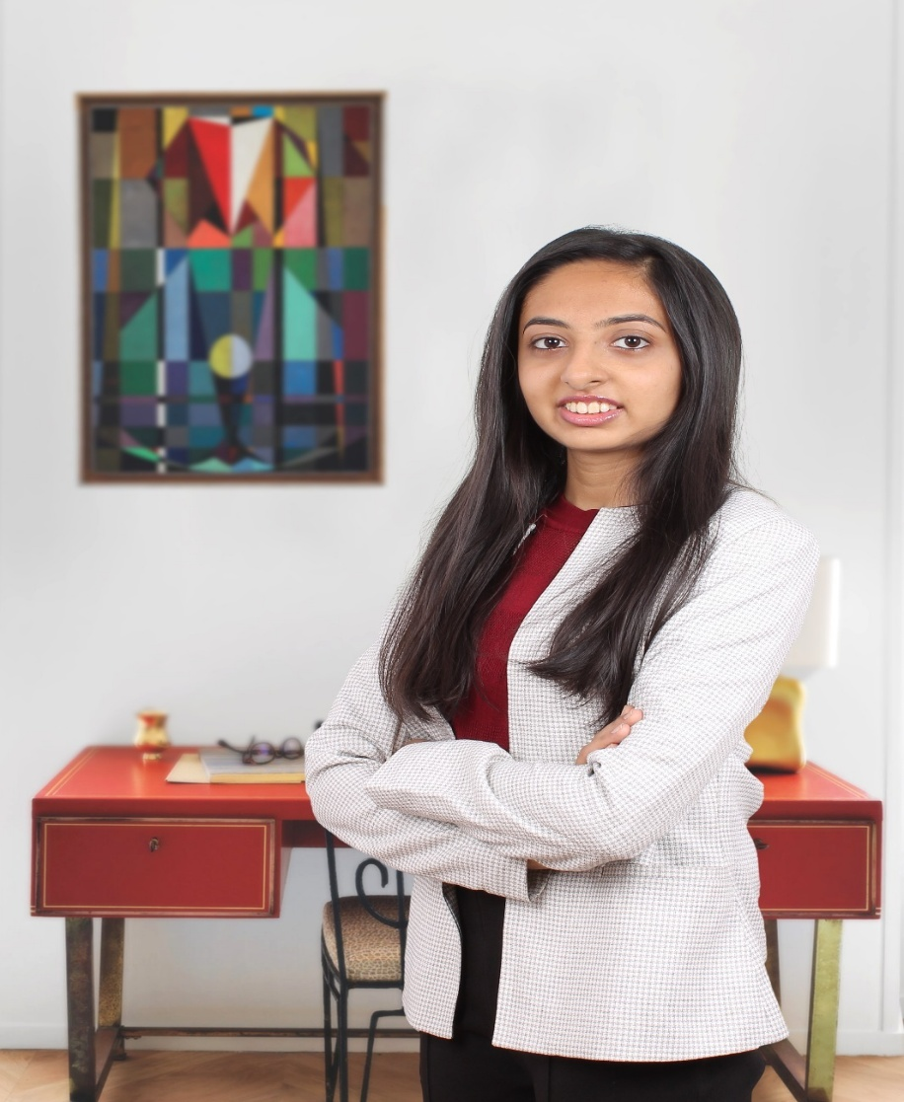
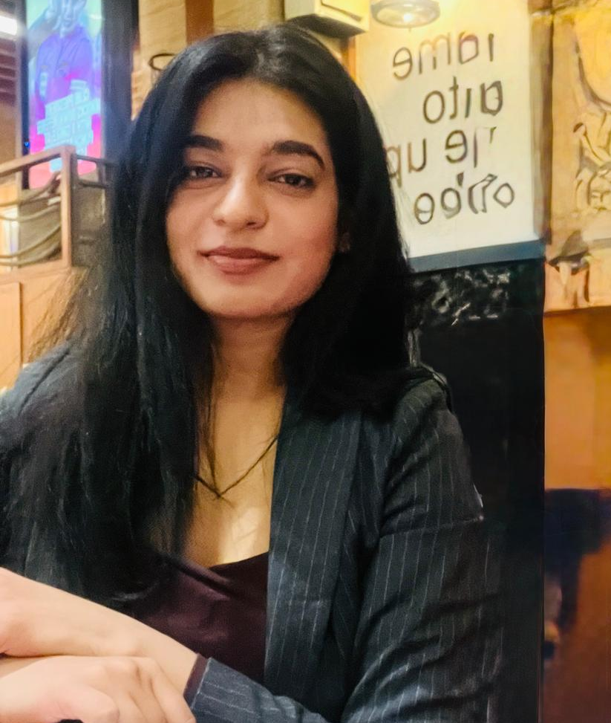



Meet the team
Heli sureja
Priyanka Singh

Slide 3

INTRODUCTIOn
01
02
03
An unbeatable ai for tic tac toe
Uses minimax algorithm with alpha beta pruning
Python-based with pygame gui

Slide 4
Project objective
Reduce computation time using alpha-beta pruning.
m agents.
Implement an AI that plays optimally in all Tic Tac Toe scenarios.
Reduce computation time using alpha-beta pruning.
Analyze performance against human and random agents.

Slide 5

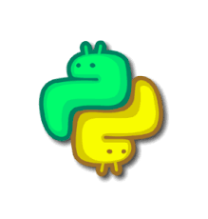
Tools and technologies
🎲
01
Python
02
Pygame (GUI rendering and input handling)
03
Random Module (simulate basic bot moves)
04
Time module

Slide 6
What is minimax ?
Used in two-player games for decision making.
AI maximizes its score, minimizes opponent's.
Results in perfect play: win or draw.

Slide 7
What is alpha-beta pruning ?
Improves Minimax efficiency.
Skips evaluating irrelevant game paths.
Faster AI decisions with same optimal result.

Slide 8
Research Questions & Methodology
Research question
Can an AI agent using Minimax with Alpha-Beta Pruning consistently outperform random or human strategies in Tic Tac Toe?
Methodology:
Represent all possible game moves (game tree)
Use Minimax to simulate decisions
Apply Alpha-Beta pruning to reduce computation
Compare against random and human strategies

Slide 9
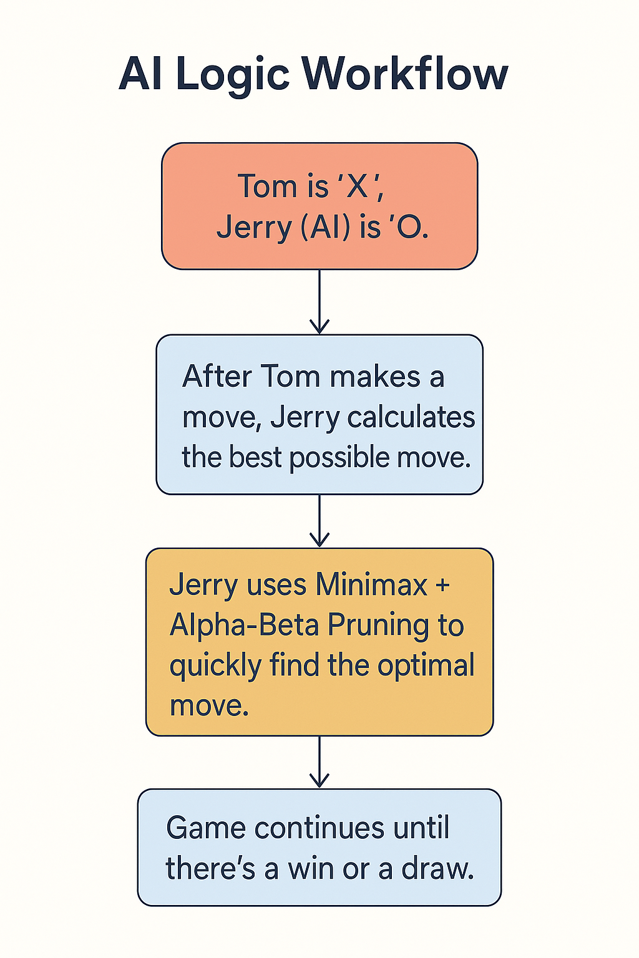
Workflow

Slide 10
Code structure
main.py - Manages the game loop and user interface for gameplay
game.py - GUI and game rules using Pygame
ai.py - Implements Minimax algorithm with Alpha-Beta Pruning for optimal AI moves.
ai_simple.py – Provides a basic AI opponent without pruning- useful for benchmarking.
random_bot.py - Random move generator

Slide 11
Evaluation Metrics
✅ Win Rate – Consistently beats random bots
✅ Optimality – Never loses due to exhaustive evaluation
✅ Efficiency – Pruning greatly improves response time
✅ Feedback – Engaging and realistic AI behavior

Slide 12
Demonstration
Game Demonstration – AI in Action
Launch the game via main.py and select player vs AI mode.
Observe AI decision-making in real-time using Minimax with Alpha-Beta Pruning.
Showcase differences in performance between:
AI with pruning (ai.py)
Simple AI (ai_simple.py)
Random bot (random_bot.py)
Demonstrates how pruning reduces unnecessary computations and improves speed.

Slide 13
Challenges Faced
01
Implementing a recursive Minimax algorithm that evaluates all possible outcomes without breaking the logic.
02
Managing the Pygame events to keep the game responsive.
03
Optimizing AI speed while preserving accuracy using Alpha-Beta Pruning.

Slide 14
Learnings
02
Enhanced problem-solving skills by analyzing game states and AI behavior.
03
Understood the importance of modular code design, unit testing and value of optimizing algorithms for speed.
01
Gained hands-on experience in adversarial search and game tree pruning.

Slide 15
Conclusion
Successfully built an intelligent Tic Tac Toe agent that never loses.
Leveraged Minimax with Alpha-Beta Pruning to optimize AI performance.
Demonstrated clear understanding of decision trees and search space reduction.

Slide 16
Future Scope
Extend AI to larger boards (e.g., 4x4) or games like Connect Four.
Add GUI using libraries like Tkinter for better user experience.
Add multiplayers
Track win/draw stats and display performance graphs
Explore reinforcement learning-based agents for adaptive gameplay.

Slide 17

Thank you!
If you have any questions, please reach us out at :
psing21@unh.Newhaven.edu
hsure2@unh.Newhaven.edu
Github link - https://github.com/psing21/TicTacToe-AI-Project
Under Guidance of:
Prof. Shivanjali Khare

